Slide 1
SAP1-Plus Ultra
1

Slide 2
Group:- G7
Team:-
Ibrahim Samy Section 1
Yahia Mohammed Section 4
Yahia Shaban Section 4
Youssef Samy Section 4
2

Slide 3
Youssef Samy
3

Slide 4
SAP-1 is the first stage in the evolution towards modern computers.
The main purpose of SAP is to introduce all the crucial ideas behind computer operations.
Being a simple computer, SAP-1 also covers many advanced concepts.
SAP-1 is a bus organized computer. All registers are connected to the W bus with the help of tri-state buffers.
4

Slide 5
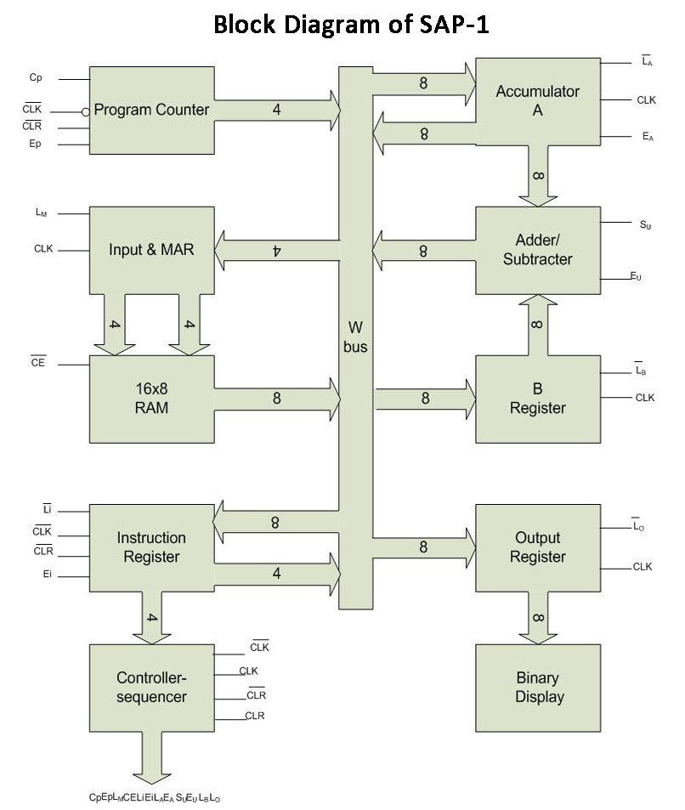
Simple-As-Possible.
One output device with 8 LEDs
32 bytes of Memory.
7 instructions
3 with 1 operand
4 with no operand.
Accumulator Architecture
Accumulator
Out Register
B Register
Word size 8-bit
5
2-bit
MAR
ALU
5
5
5
RAM 32x8
5
3
5

Slide 6

Architecture
8-bit "W" bus.
5-bit program counter, only counts up, it
starts counting from 0 and counts up to 31.
5-bit Memory Address Register (MAR).
32 Byte Memory.
8-bit (1 Byte) Instruction Register (IR).
5-cycle controller with 13-bit
control signal
8-bit Accumulator.
8-bit B Register.
8-bit ALU.
8-bit Output Register.
6

Slide 7
Processor Updating
How to make the SAP-1 Better
7

Slide 8
01
RAM Size
02
ISA
Make the RAM Bigger
Add More Instructions
03
Execute Time
04
ADDER/SUBTRACTOR
Decrease The execution time
Add more functionality
Goals
8

Slide 9
Old vs New (Instruction)
Instruction
The instruction consists of 8bits:
Divided to:
4 bits address
4 bits opcode
Old
7
4
3
0
Opcode
Address of Operand
Instruction
The instruction consists of 8bits:
Divided to:
5 bits address
3 bits opcode
New
7
5
4
0
Opcode
Address of Operand
9

Slide 10
Result
Version | Accessible Locations | Max No of Instructions
Old | 2⁴ = 16 | 2⁴ = 16
New | 2⁵ = 32 | 2³ = 8
The #instructions has decreased but still sufficient
10

Slide 11
Old vs New (ALU)
ADDER/SUBTRACTOR
It can only do some arithmetic operations such that ADD & SUB
Old
ALU
New
By adding some logical operations such that Logical Shift Right & Shift left
It has become an ALU
11

Slide 12
Result
ALU
ADD/SUB
Logical Shift Right Operation Hardware
Logical Shift Left Operation Hardware
Multiply Operation Software
Division Operation Software
12

Slide 13
Old vs New (Controller)
Instruction Execute Time
Any Instruction Takes 6 time signals to be executed
3 time signals for fetch
3 time signals for execute
Old
Instruction Execute Time
Make the fetch takes only 2 time signals
Reset the signal counter immediately after the instruction execution finish
New
13

Slide 14
Result
Make the Processor Faster
Less Power Consumption
14

Slide 15
Yahia Shaban
15

Slide 16
Blocks
16

Slide 17


Program counter
When SAP-1 is Running Mode )Cp is active), the (5-bit) address is generated by the Program Counter which is then stored into the MAR through W bus (Ep is active).
The MAR stores the (5-bit) address of data and instruction which are placed in memory.
C
p
Program counter
CLK
5
A bit later, the MAR applies this 5-bit address to the RAM, where Data or instruction is read from RAM
CLR
E
P
17

Slide 18


MAR
The MAR stores the (5-bit) address of data and instruction which are placed in memory.
When SAP-1 is Running Mode, the (5-bit) address is generated by the Program Counter which is then stored into the MAR through W bus.
A bit later, the MAR applies this 5-bit address to the RAM, where Data or instruction is read from RAM.
MAR
L_{M}
5
5
18

Slide 19
Memory
In initial design, the RAM is a 32 x 8 static TTL RAM. It means there are 32 memory locations (from 0 to 31) and each location contains an 8-bit of data/instruction.
You can program the RAM to be used for address and data. This allows you to store a program and data in the memory before a computer run.
During a computer run, the RAM receives 5-bit addresses from the MAR and a read operation is performed,
in this way, the instruction or data stored in the RAM and when is low the data placed on the W bus for use in some other part of the computer.
5
RAM
32*8
8
C_{E}
C_{E}
19

Slide 20
Instruction Register
When the instruction is placed at bus from memory, the Instruction Register stores this instruction on the next rising clock edge.
The contents of the instruction register are split into two parts.
Instruction Register
L_{I}
8
The upper part (3-bit) is a two-state output that goes directly to the block labeled "Controller-sequencer“
5
E_{I}
3
The lower part (5-bit) is a three-state output that is read onto the bus when is low
E_{I}
20

Slide 21
Yahia Mohamed
21

Slide 22
Accumulator
To add/sub/shift two 8-bit numbers A and B, the accumulator register stored the number A.
The Accumulator has two outputs.
One output goes to the ALU
The other goes to the bus through tri-state buffers.
8
Accumulator
L
A
8
CLK
E
It also stores the (answer of two values) output of ALU through w-bus, when L is low.
A
A
8
It’s value is appeared on w-bus when E is high, which can then be read by output register.
A
22

Slide 23
B Register
To add/sub/ shift two 8-bit numbers A and B, the B register stored the number B.
It supplies the number to be added or subtracted from the contents of accumulator to the ALU.
8
When data is available at W-bus and L goes low, at the rising clock edge, B register loads that data.
B
B Register
L
B
8
CLK
23

Slide 24
ALU
SAP-1 uses a 2's complement adder-subtractor. When input S_{u} is (logic 00), the sum is:
S = A + B
When S_{u} is (logic 01), the Shift Right is:
S = A >> 1
8
When S_{u} is (logic 10), Shift left is:
S = A << 1
ALU
S
u
8
E
When S_{u} is (logic 11), the sub is:
S = A + B’ + 1
u
8
The ALU is combinational and its contents change as soon as the input changes
24
When E_{U} is high, these contents appear on the W bus.

Slide 25


Output Register
At the end of an arithmetic operation the accumulator contains the word representing the answer.
Then answer stored in the accumulator register is then loaded into the output register through W-bus.
Output Register
Lo
This is done in the next positive clock edge when E_{A} is high and L_{O} is low.
25

Slide 26
Controller
Opcode
The Control Unit is responsible for linking all the components together
3
The Controller receives 3-bit opcode from IR register
Controller / Sequencer
Then it executes the Instruction using 13-bits different Control Signals
Control Signals :-
13
C_{P} E_{P} L_{M} C_{E} L_{I} E_{I} L_{A} E_{A} S_{U}(2bits) E_{U} L_{B} L_{O}
Control Signals
26

Slide 27
Control Signals
Signal | Size | Active | Function
C_{P} | 1 bit | High | Increase the PC
E_{P} | 1 bit | High | Write PC content on BUS
L_{M} | 1 bit | Low | Load MAR from BUS
C_{E} | 1 bit | Low | Write RAM content on BUS
L_{I} | 1 bit | Low | Load IR from BUS
E_{I} | 1 bit | Low | Write IR content on BUS
L_{A} | 1 bit | Low | Load ACC from BUS
E_{A} | 1 bit | High | Write ACC content on BUS
S_{U} | 2 bits | N/A | Select ALU operation
E_{U} | 1 bit | High | Write ALU content on BUS
L_{B} | 1 bit | Low | Load Register B from BUS
L_{O} | 1 bit | Low | Load OUT Register from BUS
Controller / Sequencer
C_{P}
C_{E}
L_{I}
L_{A}
E_{A}
E_{U}
L_{B}
L_{O}
E_{P}
L_{M}
E_{I}
S_{U}
27

Slide 28
Ibrahim Samy
28

Slide 29
SUB
LDA
Instruction Set
opcode
010 ADDRESS
AC ← AC-B
opcode
000 ADDRESS
AC←MEM[MAR]
SHIFT RIGHT
ADD
opcode
100 XXXX
AC ← srl AC
opcode
001 ADDRESS
AC←AC+B
7
5
4
0
OUT
SHIFT LEFT
Opcode
Address of Operand
opcode
101 XXXX
OUT←AC
011 XXXX
AC← sll AC
HLT
opcode
111 XXXX
CLK←0
29

Slide 30
Instruction cycle
Fetch instruction
Execute the instruction
Decode instruction
30

Slide 31
Fetch
T1,T2
During the address state, E_{P} and L_{M} are active; this means that the program counter sets up the MAR via the W bus.
During the memory state, CE' and L'_{I} are active. The addressed RAM word sets up the instruction register via the W bus. Midway through the memory state, a positive clock edge loads the instruction register with the addressed RAM word.
IR←M[AR]
A positive clock edge occurs midway through the address state; this loads the MAR with the contents of the PC.
AR←PC
This sets up the program counter to count positive clock edges. Halfway through the increment state, a positive clock edge hits the program counter and advances the count by 1.
The address, increment, and memory states are called the fetch cycle of SAP-l.
During the increment state, C_{P} C_{E} , Li is the only active control bits.
PC←PC+1
IR←M[AR]
31

Slide 32
Execution Cycle :
The next three states (T₃, T₄, and T₅) are the execution cycle of SAP-1
The register transfers during the execution cycle depend on the particular instruction being executed.
What follows are the control routines for different SAP-1 instructions.
32

Slide 33
Macro Instructions :
The instructions we have been programming with (LDA, ADD, SUB, . . .) are sometimes called macro-instructions to distinguish them from micro-instructions.
Each SAP-1 macroinstruction is made up of maximum three micro-operations. For example, the LDA macroinstruction consists of the two micro-operations.
33

Slide 34
Micro operation :
The controller-sequencer sends out control words, on during each T state or clock cycle.
These words are like directions telling the rest of the computer what to do.
Because it produces a small step in the data processing, each control word is called a micro-operation.
34

Slide 35
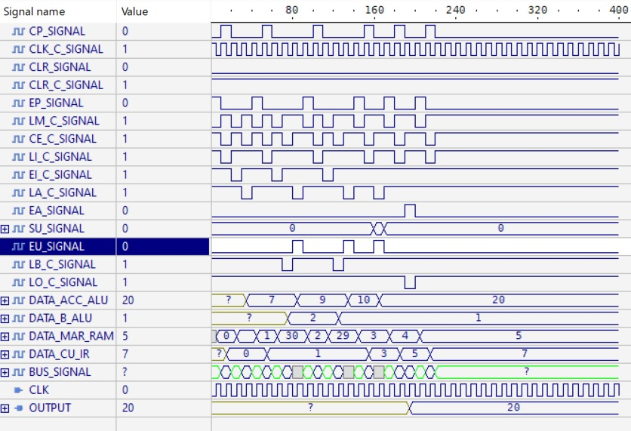
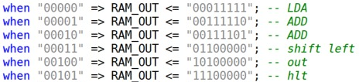

Ex:1
instruction
Data in memory
35

Slide 36
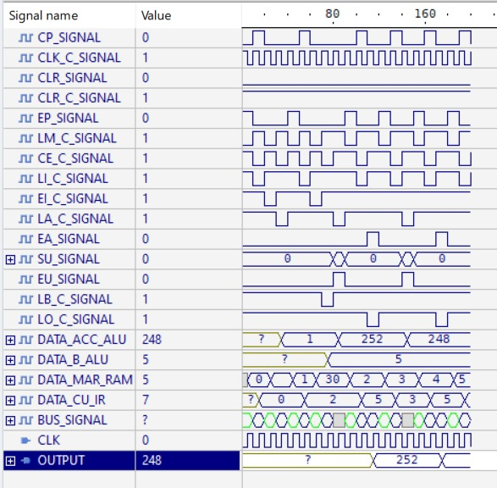

Ex:2
instruction
Data in memory
36

Slide 37
Thanks' for your time

